Slide 1
Cyber
Security
THAILAND

Slide 2




Cloud
SECURITY
Intensive

Slide 3

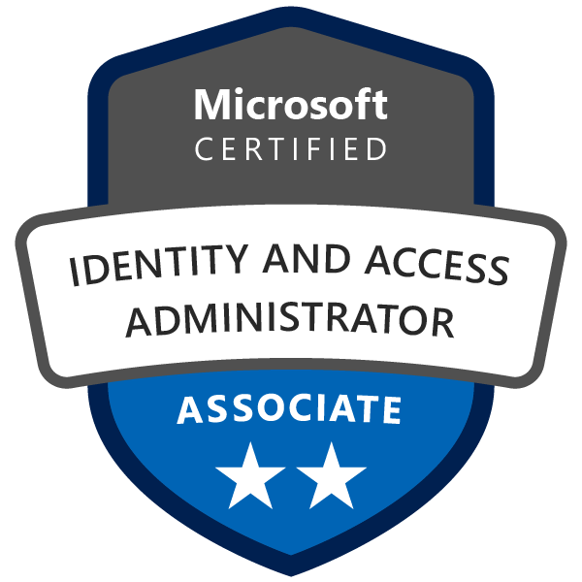
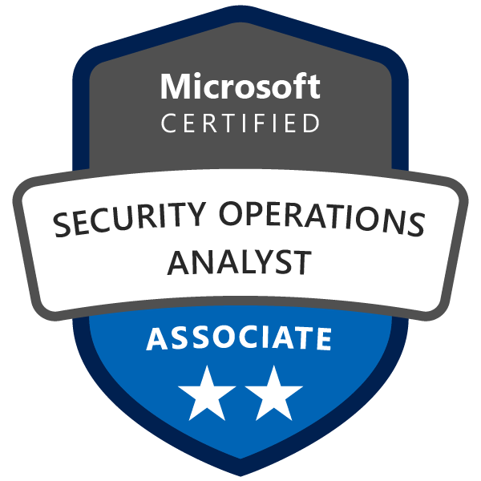
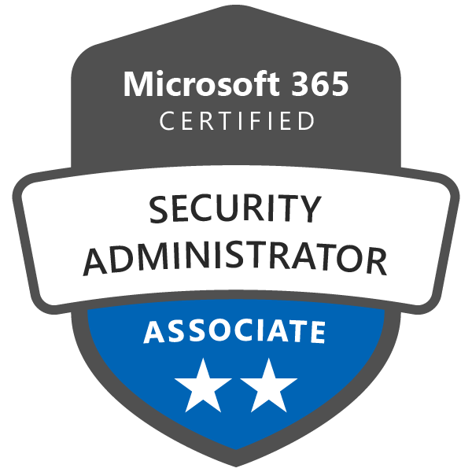
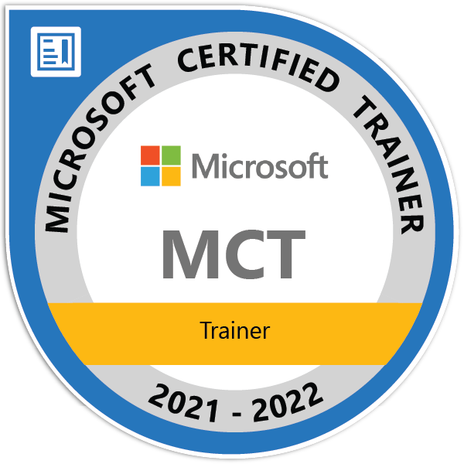
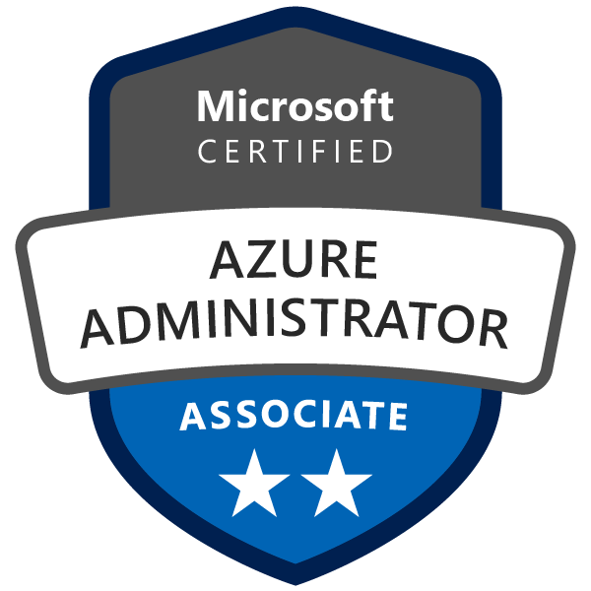

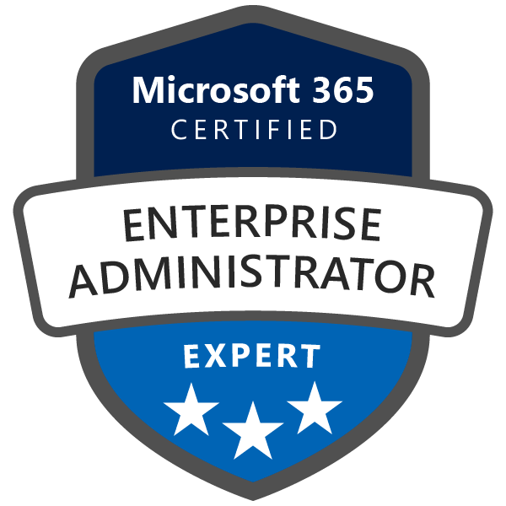



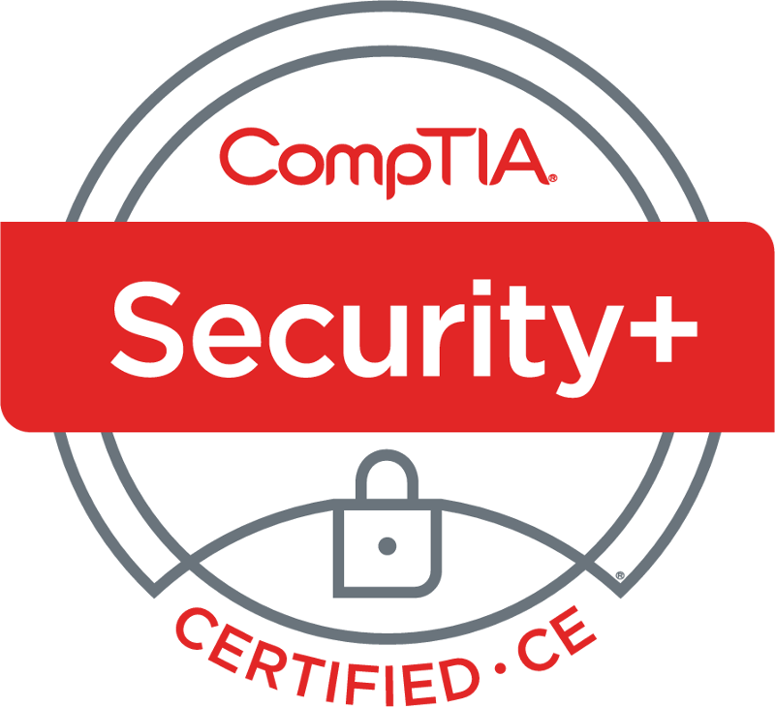
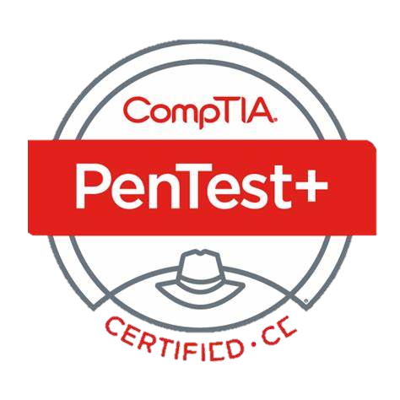
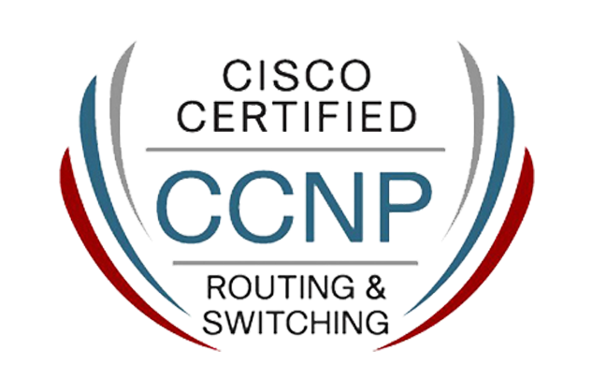
Sarah
Saran Hansakul
IT & Brand Manager
Rainbow Silver Co.,Ltd.
(AKE AKE Thailand)
C
S
S
P
I

Slide 4
1
Overview
Cloud Sec ?
Learning Tips

Slide 5







Cloud
?
17788
SP 800-145
On-demand, Self Service
Broad Network Access
Resource Pooling
Rapid Elasticity
Measured Services
Service
Deployment
IaaS
PaaS
vs FaaS ?
SaaS

Slide 6







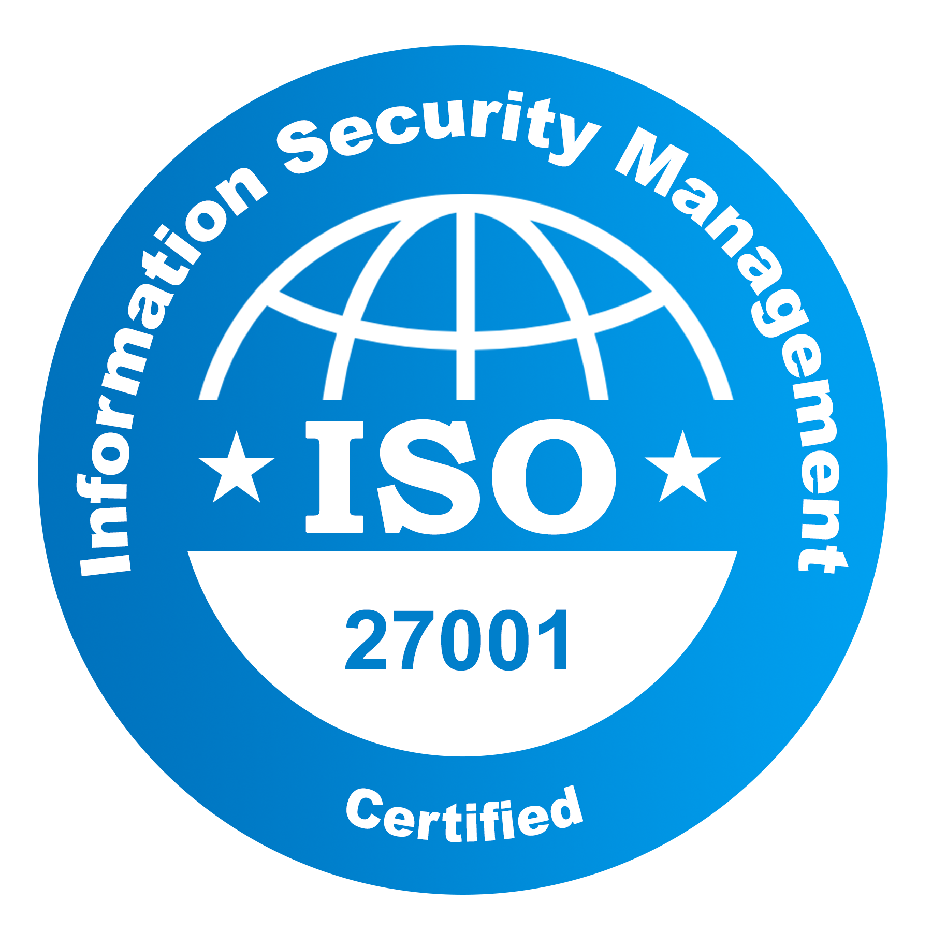

Audit
System
Netw
Specialist/Consults
Cloud Sec
Engineer
Admin
Engineer
Cost $$$?
Architect
ROI ?
Consultant
(SOC)
Analyst

Slide 7
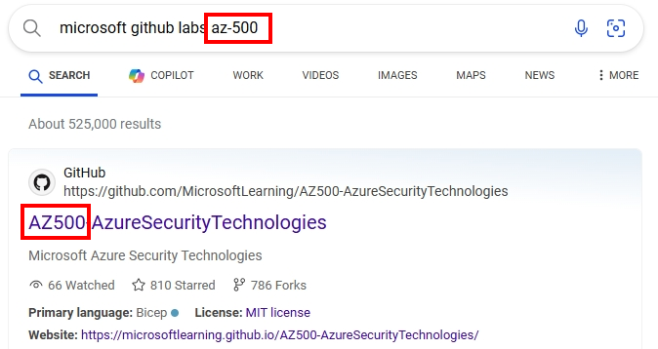
Search Github Labs with exam code
Practice / Blogging
Actual Hands-on

Slide 8
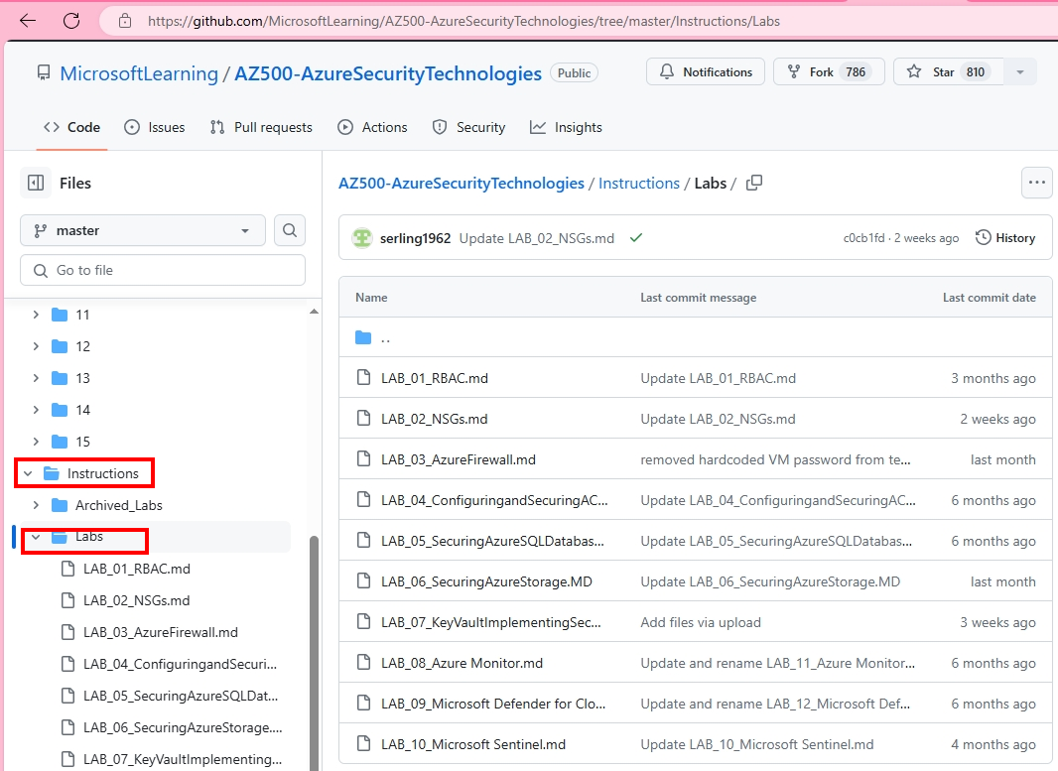
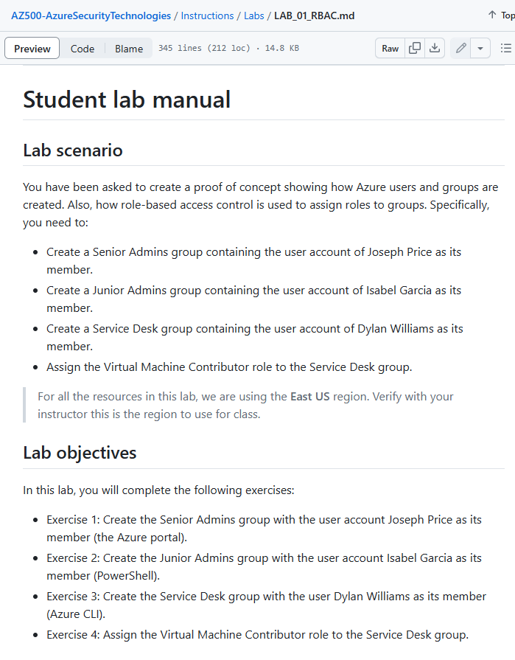

Slide 9
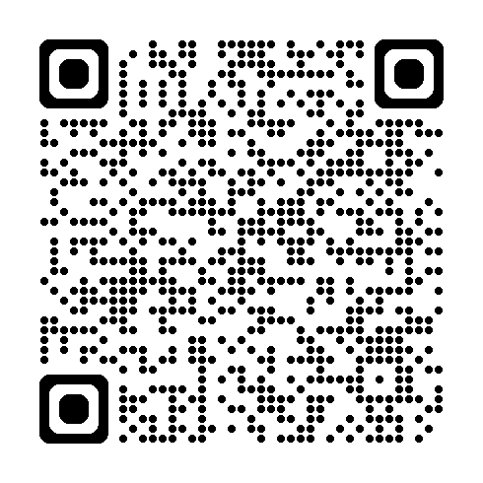
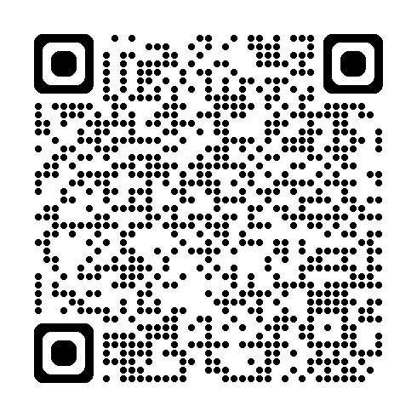
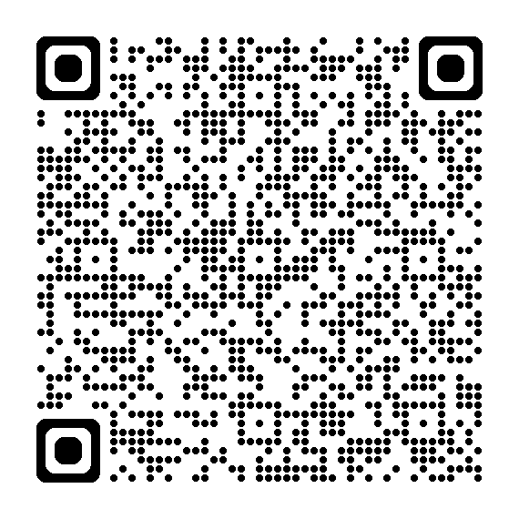
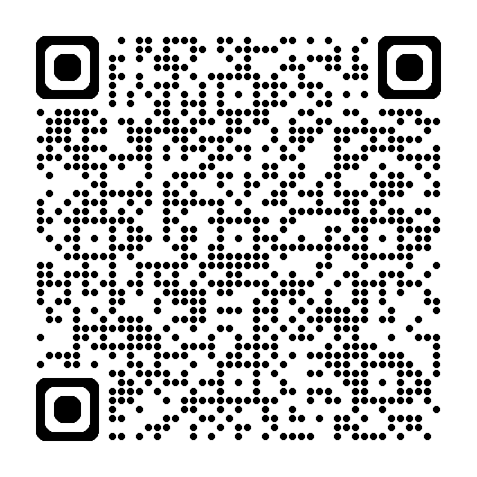
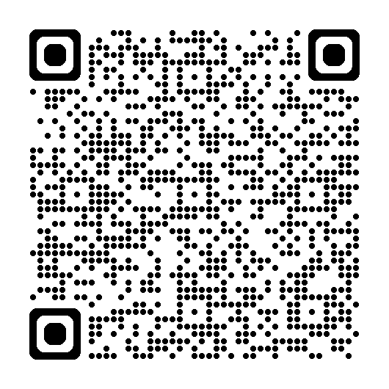
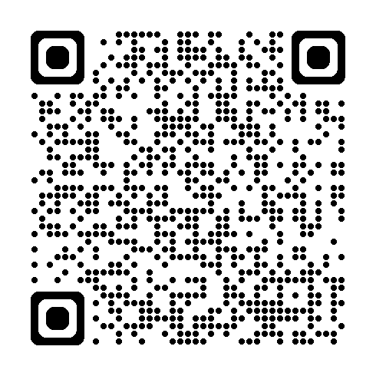
AZ-104 Labs
AZ-500 Labs
SC-900 Labs
SC-200 Labs
SC-300 Labs
SC-400 Labs

Slide 10
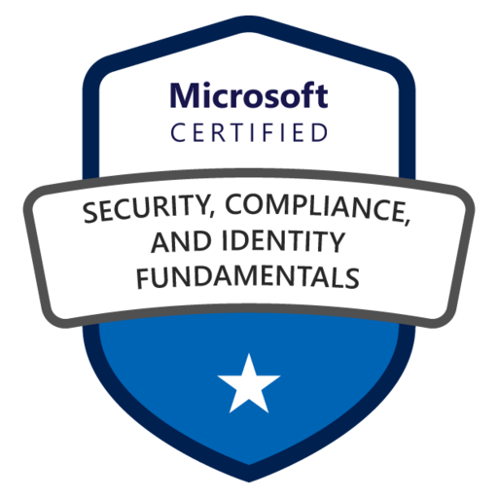
SC-900
SECURITY
COMPLIANCE
IDENTITY
CONCEPT
SECURITY
Cloud Adoption Framework
Shared Responsibility
Defense in Depth
Zero Trust
Encryption vs Hashing
SOLUTIONS
COMPLIANCE
IDENTITY
Authentication vs Authorization
Identity as Perimeter: 4 Pillars – AAA+A
Identity Provider
Directory Service (AD) vs ADaaS
Federation

Slide 11
SC-900
SECURITY
COMPLIANCE
IDENTITY
CONCEPT
SECURITY
Basic (Network + Resource Lock)
Defender for Cloud
Sentinel
365 Defender
Intune
SOLUTIONS
IDENTITY (Azure AD)
COMPLIANCE
Identity Control
Identity Types (User/Device/SP/Managed Identity) - External Identity (B2B/B2C) - Hybrid Identity (Hash/Pass-through/Federated)
Service Trust Portal / Privacy (Priva)
Purview Compliance (365)
Portal / Compliance Score
Lifecycle (Sensitivity/DLP/Retention/Record)
Insider Risk/Comm.Compli/Info Barrier
eDiscovery/Audit
Authentication
Methods (Pwd/Passwordless) - MFA - SSPR - Password Protection
Purview Governance (Azure)
Authorization (Access Management)
Conditional Access - AD Role + RBAC
Portal (Map/Catalog/Estate)
Policy
Blueprint
Governance
Entitlement/Access Review/TOU - PIM - Identity Protection

Slide 12
SC-900
SECURITY
COMPLIANCE
IDENTITY
MS Cloud
Adoption Framework
Best Practice from MS
for deploying Azure
S trategy
P lan
R eady
A dopt
G overn
M anage

Slide 13
SC-900
SECURITY
COMPLIANCE
IDENTITY
Shared Responsibility
Model
Data & Identity
Solely by Customer
App
OS
Q1: SaaS (M365) who apply SP on App?
A: Provider (MS)
Physical
Solely by Provider (MS)
IaaS
PaaS
SaaS
Q2: IaaS (VM) who manage Physical network?
A: Provider (MS)
Q3: All cloud types, who is responsible for Data security?
A: Customer

Slide 14






SC-900
SECURITY
COMPLIANCE
IDENTITY
Zero-Trust
Verify explicitly
Least Privileged
Assume Breach
Firewall cannot
secure Network perimeter
Use Identity
as perimeter

Slide 15
SC-900
SECURITY
COMPLIANCE
IDENTITY
6 Key Privacy
Principle
Control
Transparency
Security
Strong Legal Protection
No Content-based Targeting
Benefits to you

Slide 16
SC-900
SECURITY
COMPLIANCE
IDENTITY
Encryption
Viewer need “Key”
Digital Signing – prove sender identity
Private Key – for signing
Public Key – for decrypting
Type
at rest – VM disk
in transit – VPN/HTTPS/Email

Slide 17
SC-900
SECURITY
COMPLIANCE
IDENTITY
1st factor Authen: login page for Azure/M365 portal
Authentication
Prove identity
Authorization
Permit access
With Conditional Access, etc. after 1st factor Authen, e.g. to force 2nd factor Authen (MFA)

Slide 18
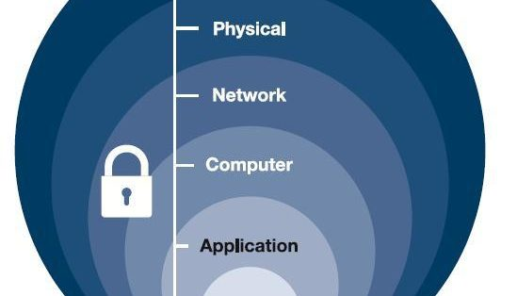
SC-900
SECURITY
COMPLIANCE
IDENTITY
Defense in Depth
Multilayer defense throughout network

Slide 19


APPLIED SKILLS
Configure SIEM security operations using Microsoft Sentinel
SaraH
Saran Hansakul

Slide 20
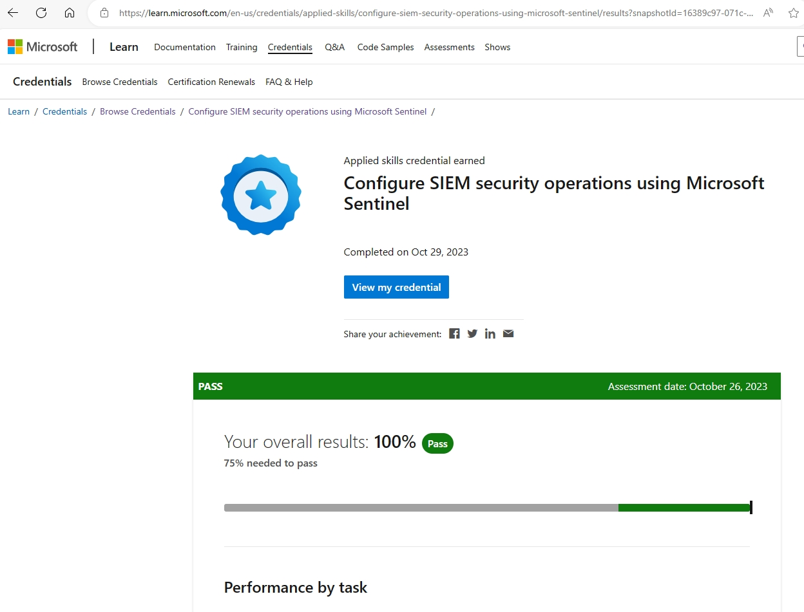

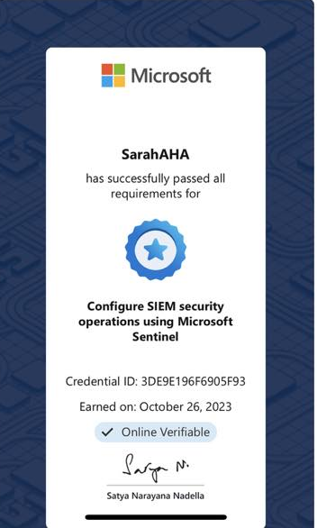
APPLIED SKILLS
Microsoft Sentinel
Love to have?

Slide 21
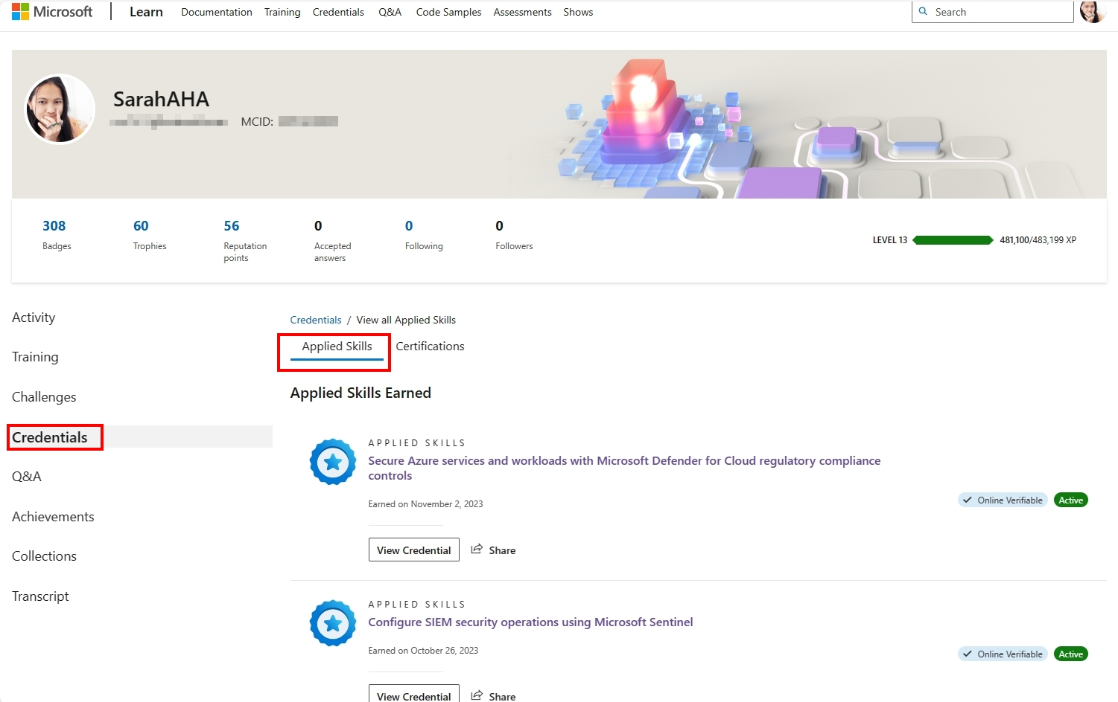
APPLIED SKILLS
Microsoft Sentinel

Slide 22











MS Sentinel
Deploy
Step 5
Content Hub
Solutions
APPLIED SKILLS
Microsoft Sentinel
Step 2
Windows Security Events
Build on:
Configuring…
Set usage >> Data Retention
Data Collection Rules
Step 4
Log Analytics
Workspace
Azure
Activity
Step 1
Configuring…
Azure Policy Assignment
Assign Sentinel Roles
IAM
of RG
Defender
for Cloud
Step 3
Least Privilege:
Manage Incident: Sentinel Responder
“Run” Playbook: Playbook Operator
Configuring…
Bi-directional Sync
Analytics Rules
Set Near Real Time (NRT) query
Automation
Set Near Real Time (NRT) query

Slide 23
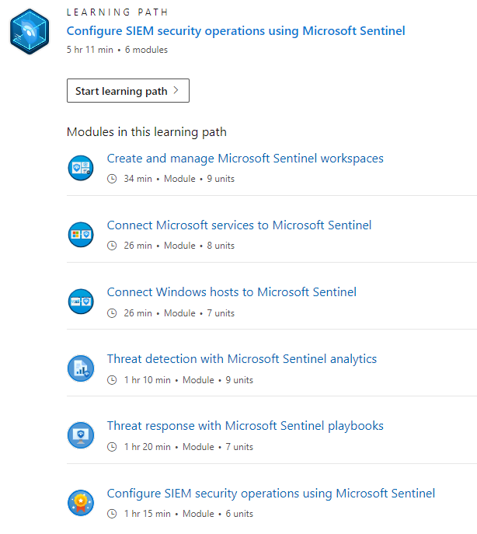
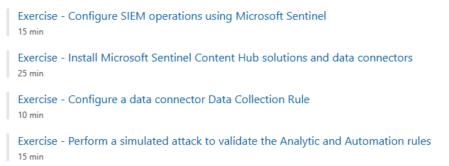
APPLIED SKILLS
Microsoft Sentinel
Online – Open Book

Slide 24
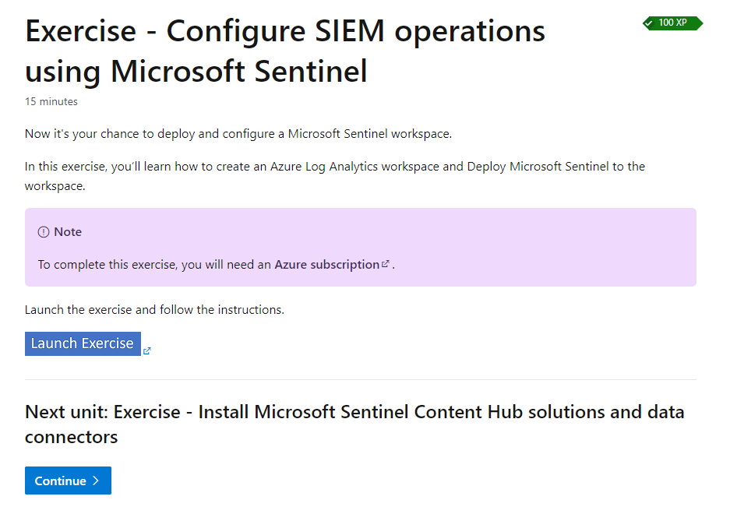
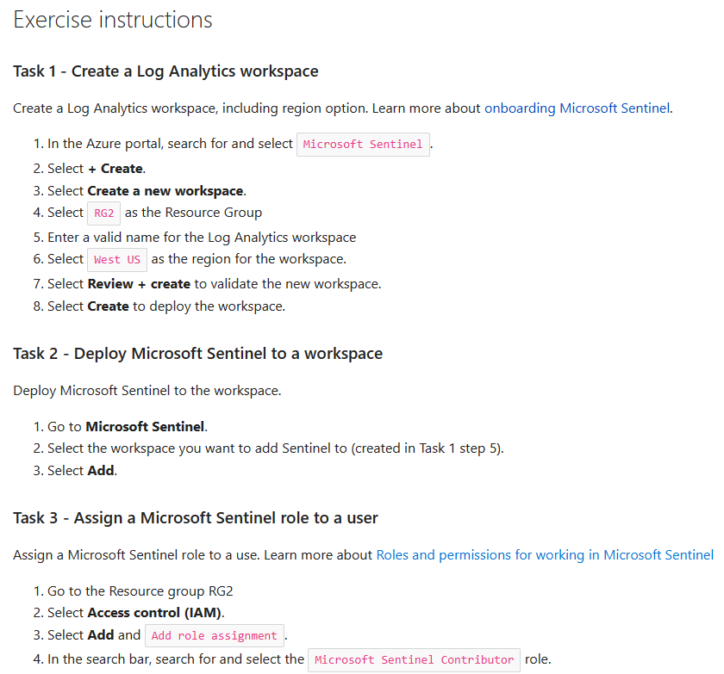
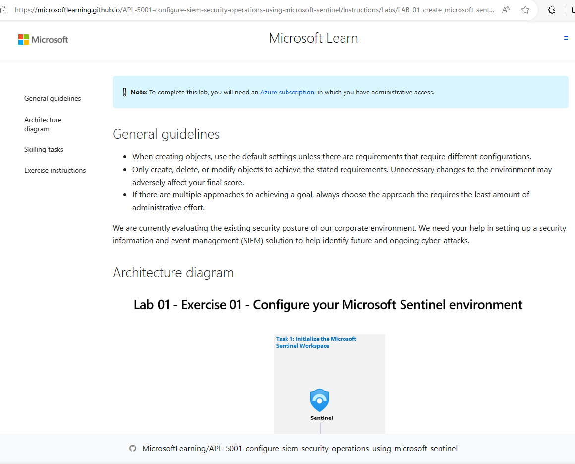
APPLIED SKILLS
Microsoft Sentinel

Slide 25
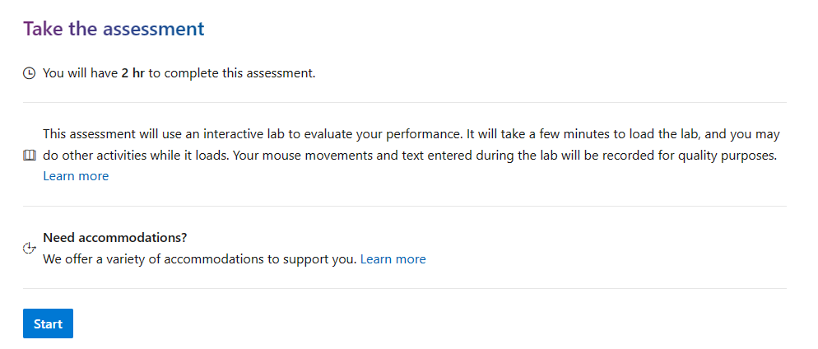
APPLIED SKILLS
Microsoft Sentinel
So…why wait?

Slide 26
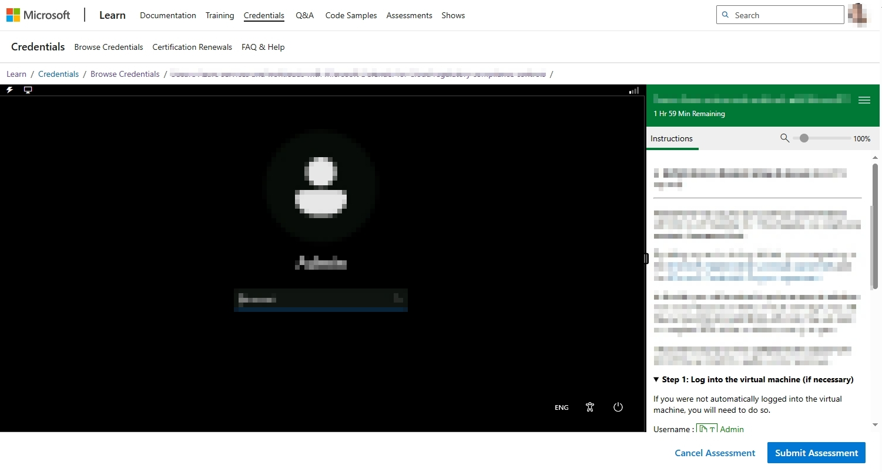
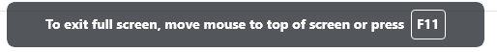
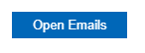
Use F11 for full screen, find big monitor
APPLIED SKILLS
Microsoft Sentinel
Login to desktop first with provided user/pass
Then scroll direction down to click this.
Submit when every job complete.

Slide 27
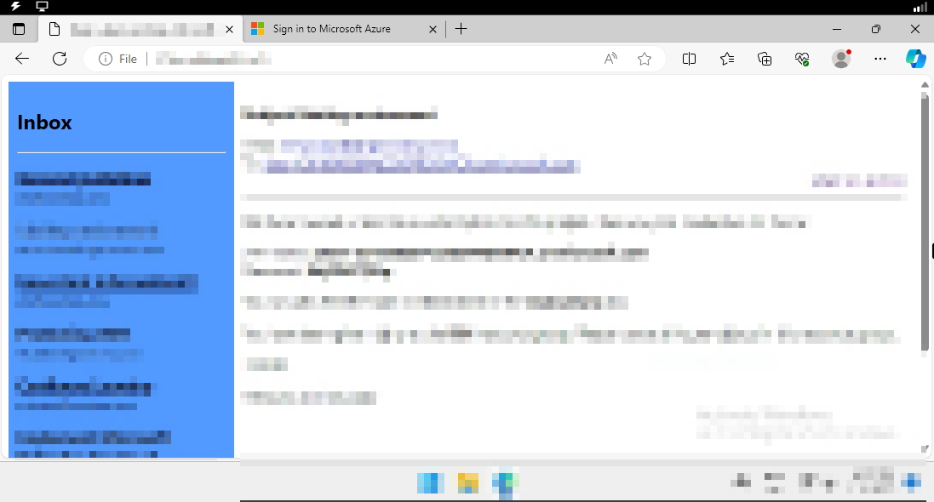
APPLIED SKILLS
Microsoft Sentinel
Direction mail

Slide 28
Tips
APPLIED SKILLS
Do not wait for processing, open many Azure tabs and go ahead each job.
Beware of what the direction mail specified: Resource Group, Region, user, resource name, etc.
Use Default Settings if it is not instructed.
Do not do unnecessary change.
Microsoft Sentinel

Slide 29
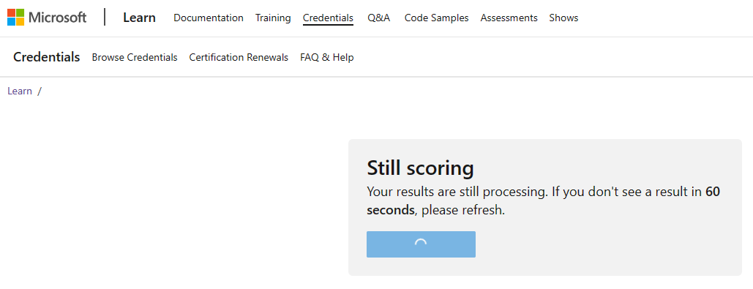
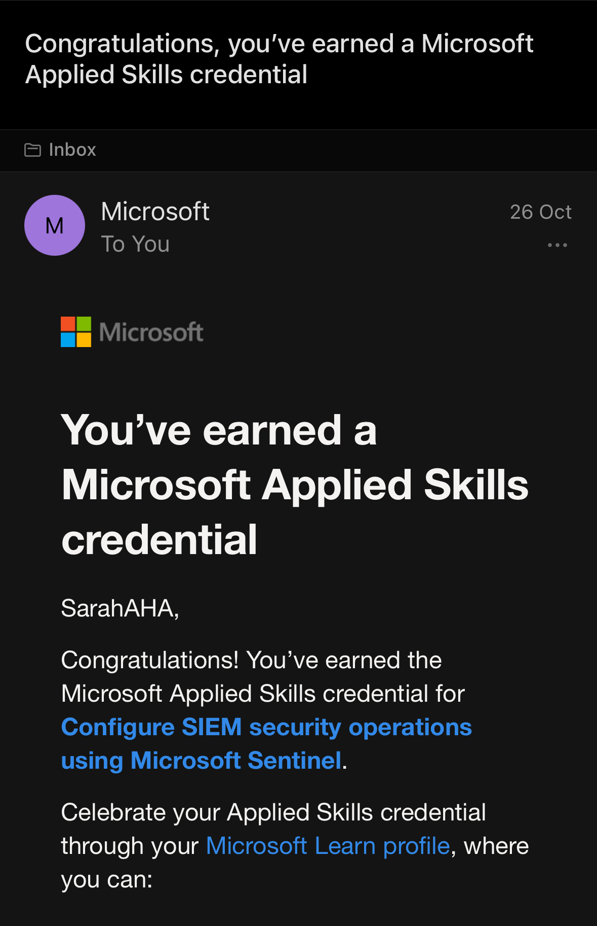
APPLIED SKILLS
Microsoft Sentinel
Just refresh every 60 secs.

Slide 30
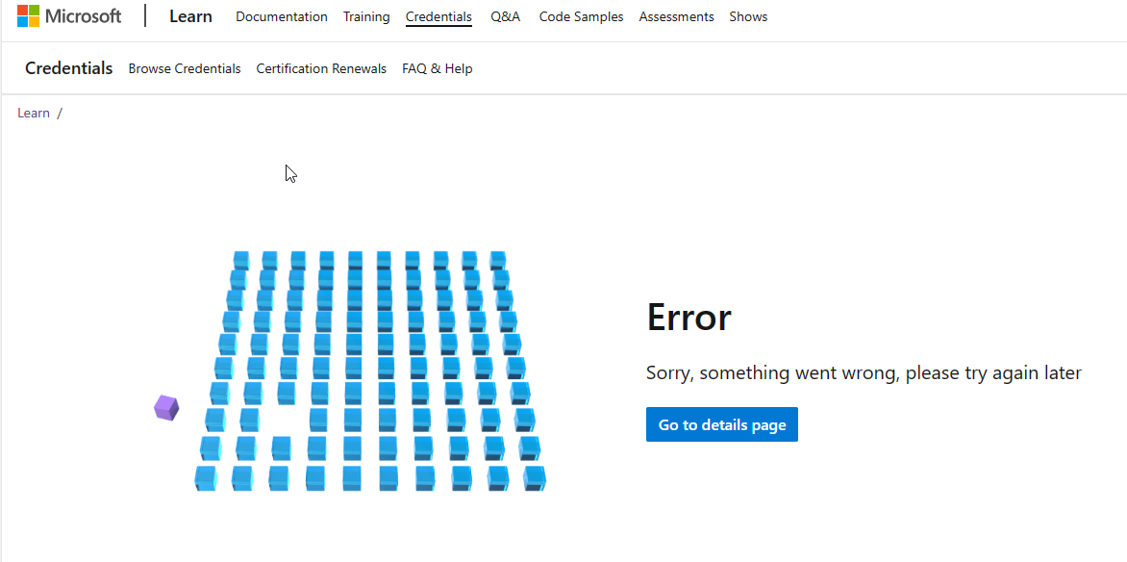
Problems and Solutions
APPLIED SKILLS
Microsoft Sentinel
Do not click!
Just back to the previous page and keep refreshing.

Slide 31
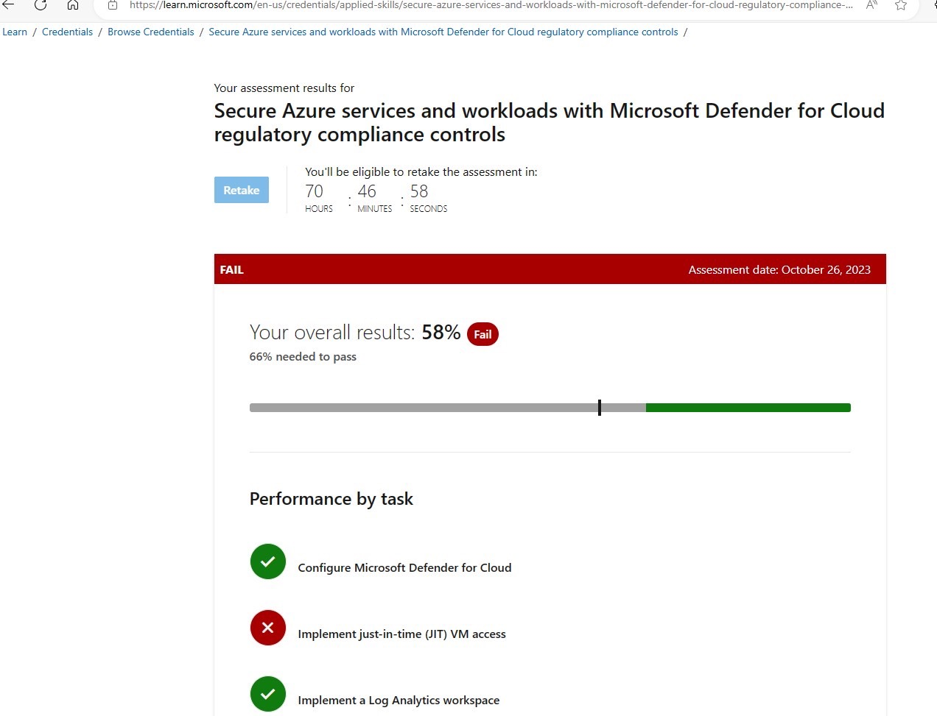
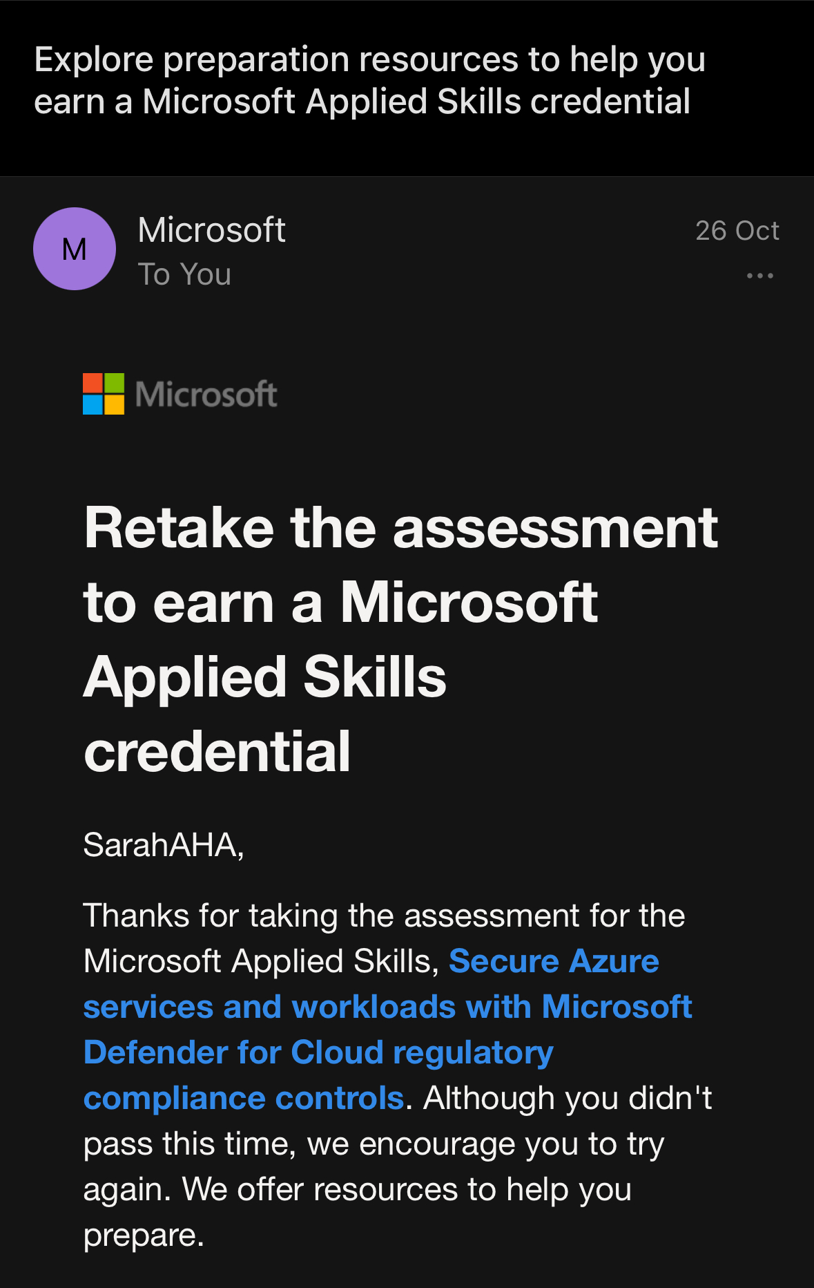
Problems and Solutions
APPLIED SKILLS
Microsoft Sentinel
Fail? Wait for another 72hrs.
Count from beginning of the lab.

Slide 32
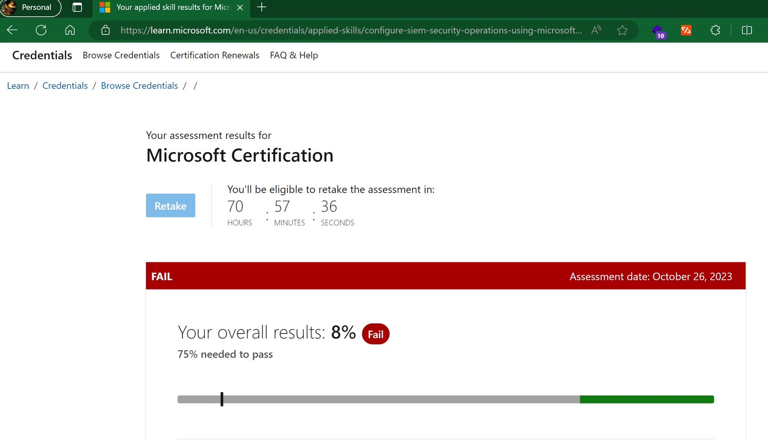
Problems and Solutions
APPLIED SKILLS
Microsoft Sentinel
Fail but seems buggy (no confirm mail), just go taking again!

Slide 33
Exam Example in SC-900
Security Concepts
have best practices from Microsoft to assist in Azure Development, such as tools and guidances
Resource Lock
Azure Blueprint
MS Cloud Adoption Framework
Azure Blueprint
Answer: Microsoft Cloud Adoption Framework
Hint: best practices from Microsoft

Slide 34
Exam Example in SC-900
Security Concepts
Microsoft, as cloud provider, is solely responsible for:
Physical Hardware Management
Endpoints Management
Manage user accounts
Manage data stored on Azure
Answer: Physical Hardware
Hint: best practices from Microsoft

Slide 35
Exam Example in SC-900
Security Concepts
Please answer each question:
One of the Zero-trust principle is Assume Breach. Yes/No
Zero-trust means firewall can protect internal network. Yes/No
One of the Zero-trust principle is Verify Explicitly. Yes/No
One of the Zero-trust principle is Least Privilege. Yes/No
Answer: Y/N/Y/Y
Hint: Zero-Trust = Verify Explicitly + Least Priviledge + Assume Breach

Slide 36
Exam Example in SC-900
Security Concepts
3 things that are the truth for Zero-Trust:
Network is new Security Perimeter/Boundary
Identity is new Security Perimeter/Boundary
Physical Location is new Security Perimeter/Boundary
Users are always verified their permission explicitly
Apps or other Service Principles are no need to be always verified
Always assume that our system is breached, to actively finding threats. limit segments etc.
Answer: BDF
Hint: Zero-Trust = New Boundary is Identity (Users/Devices/App/other SPs+Signal) with 3 principles: Verify Explicitly, Least Privileges, Assume Breach

Slide 37
Exam Example in SC-900
Security Concepts
Please answer each question:
Control is key privacy principle of MS Yes/No
Shared Responsibilities is key privacy principle of MS Yes/No
Least Privilege is key privacy principle of MS Yes/No
Transparency is key privacy principle of MS Yes/No
Answer: Y/N/N/Y
Hint: Control/Transparency/Security/Strong Legal Protection/No Content-based Targeting/Benefits to you

Slide 38
Exam Example in SC-900
Security Concepts
files making data readable/usable only for viewer that has appropriate key.
Hashing
Deduplicating
Encryption
Compressing
Answer: Encryption
Hint: Encryption use key to encrypt/decrypt

Slide 39
Exam Example in SC-900
Security Concepts
Please answer each question:
Verifying digitally signed docs requires private key of signer Yes/No
Verifying digitally signed docs requires public key of signer Yes/No
Signer uses private key to digitally sign documents. Yes/No
Signer uses public key to digitally sign documents. Yes/No
Answer: N/Y/Y/N
Hint: Asymmetric Encryption: sender uses private key, receiver uses public key.

Slide 40
Exam Example in SC-900
Security Concepts
To place multilayer of defense along network infrastructure, is which security methodology?
Zero-Trust
Key Privacy Principle
CIA: Confidentiality, Integrity, Availability
Defense in Depth
Answer: Defense in Depth
Hint: Multilayer throughout Network

Slide 41
Exam Example in SC-900
Security Concepts
User must be …… when signing in Azure/M365 portal and then undergo …… process to identify whether user can access any specific resource.
Authenticated / Authorization
Authorized / Authentication
Accounted / Authentication
Authenticated / Accounting
Answer: Authenticated and Authorization
Hint: Authentication is proving if signing-in user authentic. Authorization is to authorize/give rights to access/do something to signed-in user.

